Slide 1

WAVECON TELECOM ANALYSIS

Slide 2
Overview
In June, Wavecon—one of the leading names in telecom—launched its advanced 5G service. Our goal with this analysis is to dive deep into the dashboard and uncover meaningful insights across several critical dimensions. We will look at overall revenue trends, identify any lagging key performance indicators (KPIs), and compare how the company’s various service plans are performing relative to each other.

Slide 3
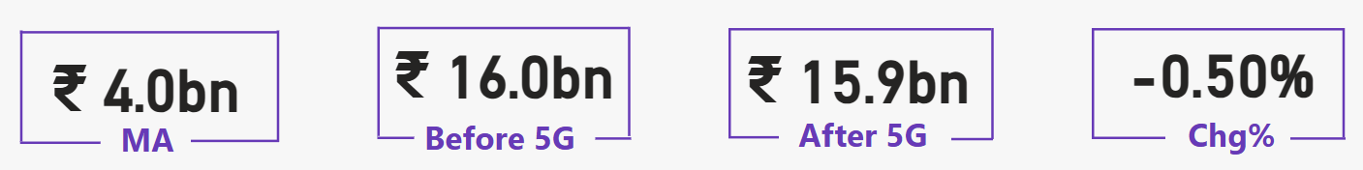
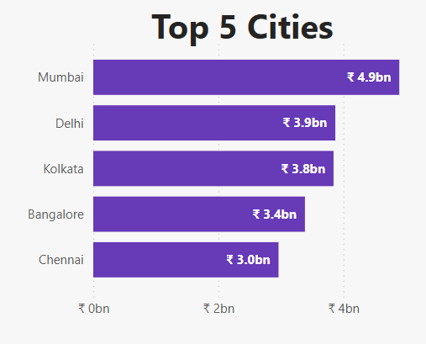
Revenue Impact Post 5G Launch
Total revenue before and after the 5G launch.
Cities with the most significant revenue changes.
Positive and negative impact.

Slide 4
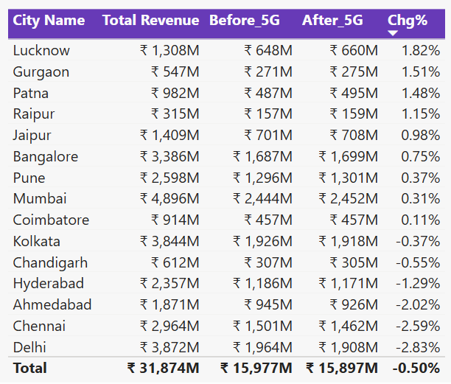
Revenue Impact Post 5G Launch
Total revenue before and after the 5G launch.
Cities with the most significant revenue changes.
Positive and negative impact.

Slide 5
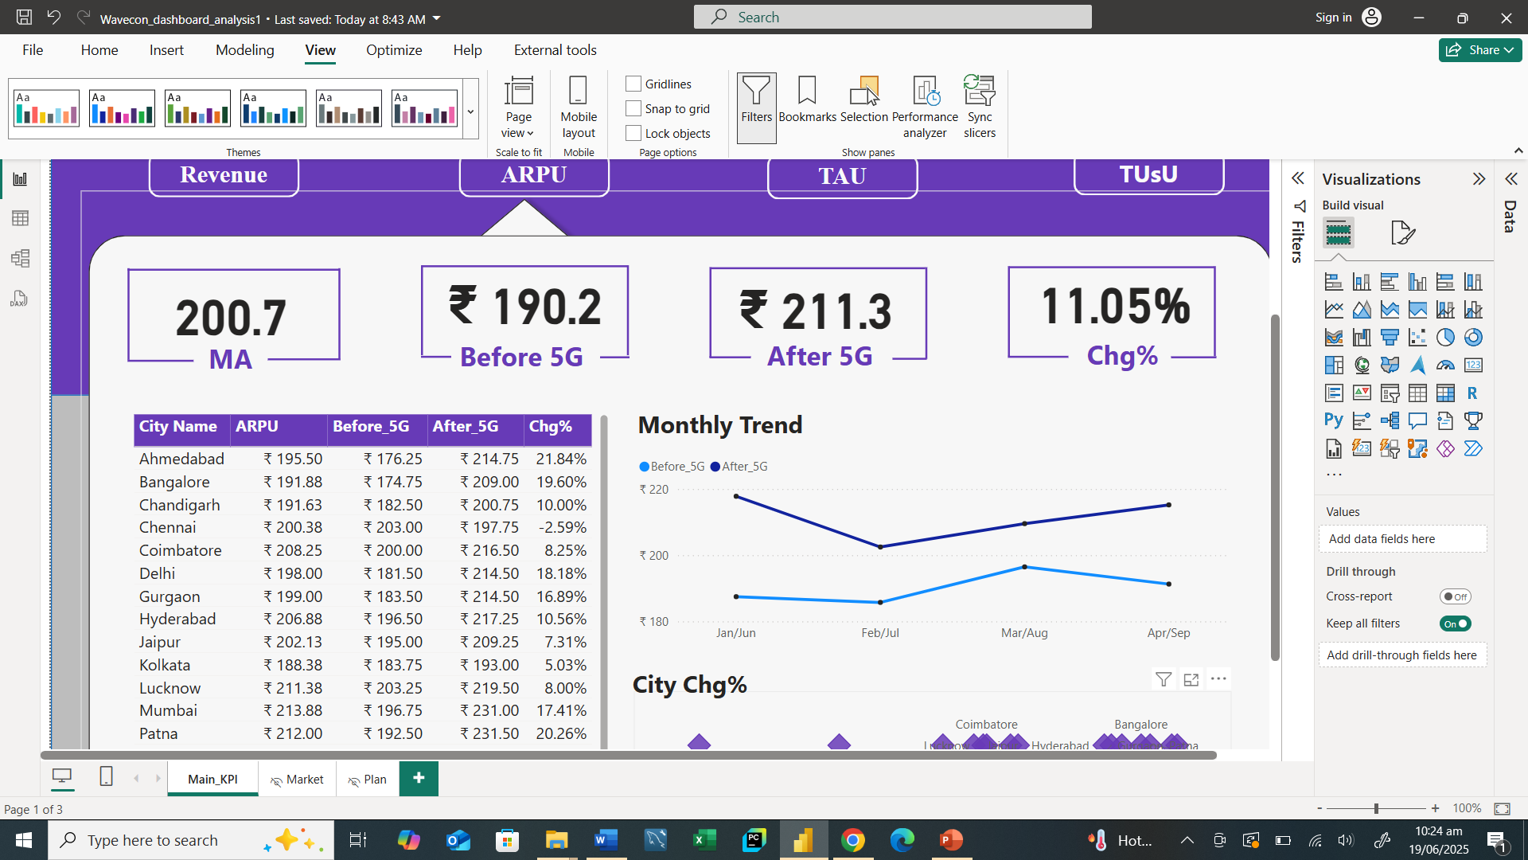
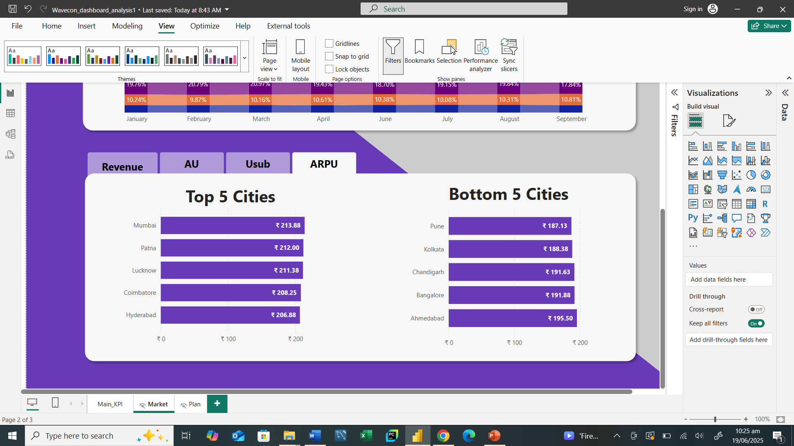
ARPU Analysis Post 5G Launch
ARPU – Average Revenue Per User
Average Revenue Per User (ARPU) before and after the 5G launch.
Top and bottom ARPU cities.
Cities with notable ARPU increase and decrease.

Slide 6
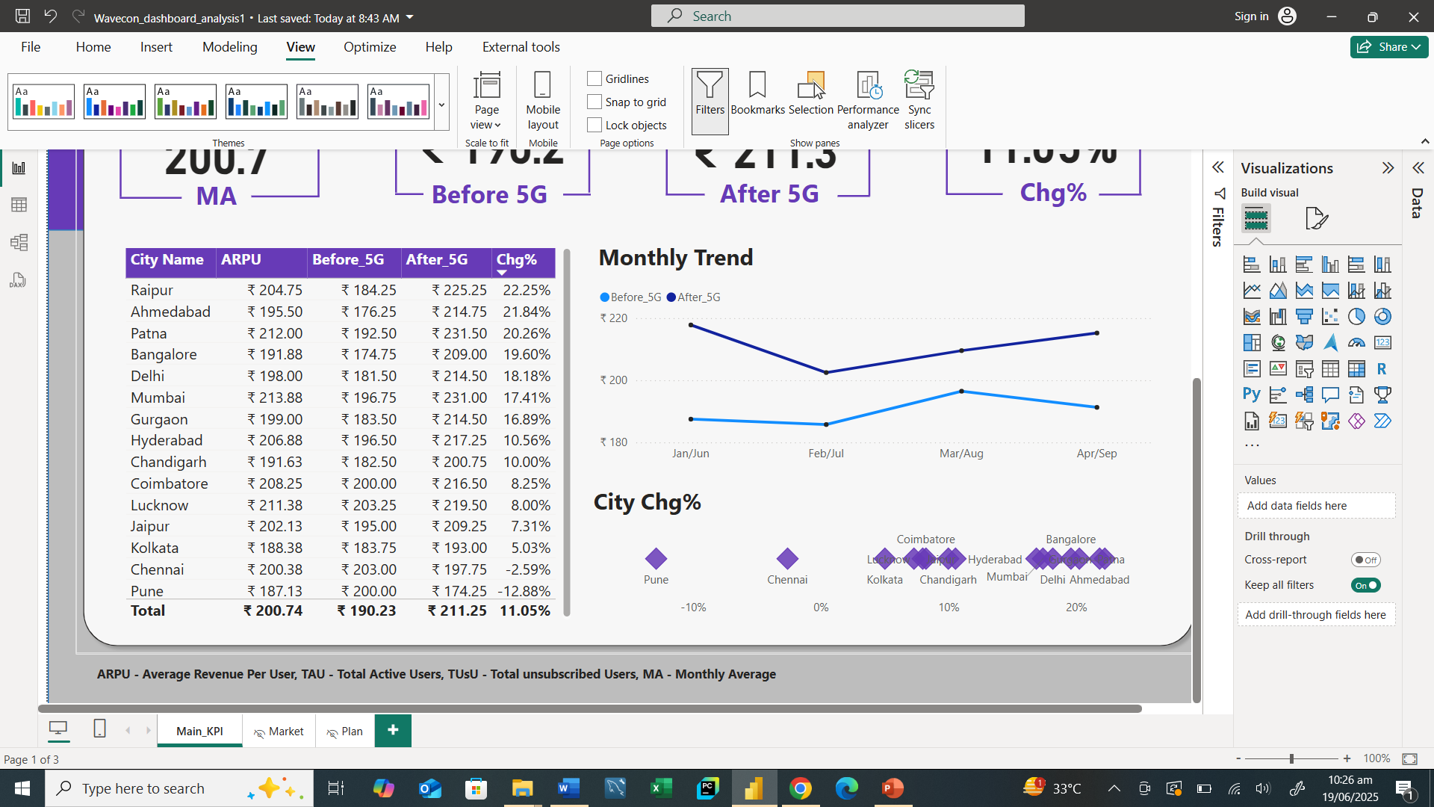
ARPU Analysis Post 5G Launch
ARPU – Average Revenue Per User
Average Revenue Per User (ARPU) before and after the 5G launch.
Top and bottom ARPU cities.
Cities with notable ARPU increase and decrease.

Slide 7
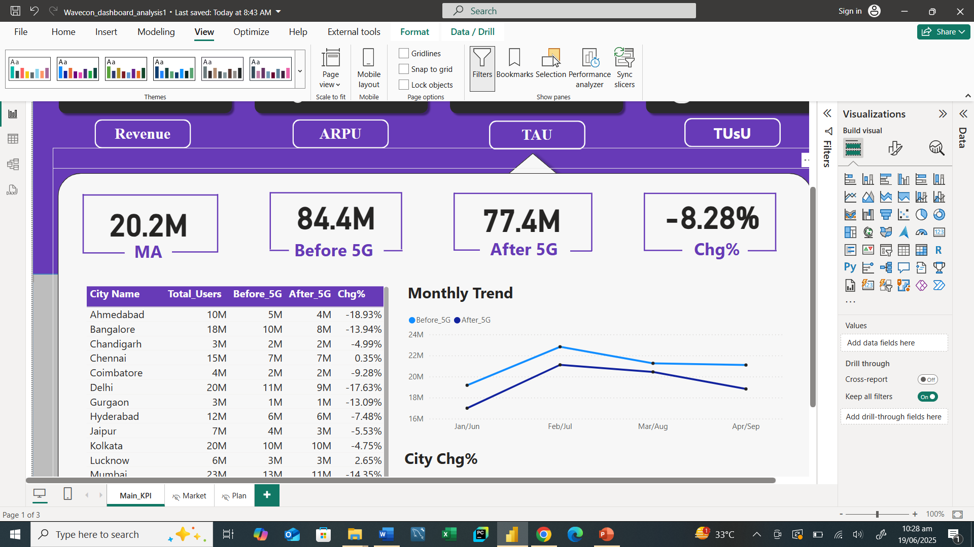
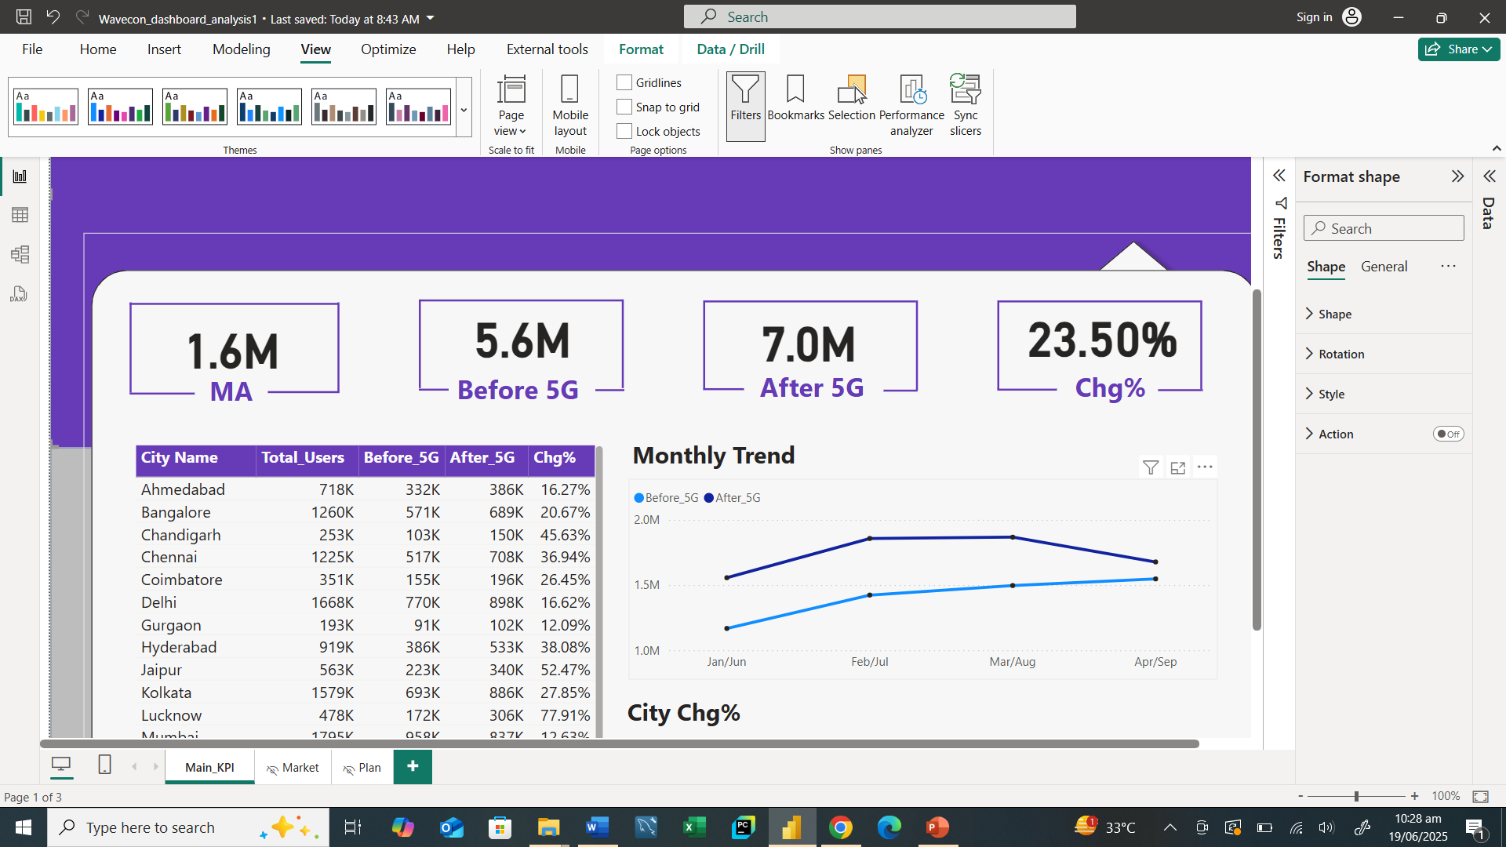
Underperforming KPIs Post 5G Launch
TAU - Total Active User
Underperforming KPIs (TAU and TUsU).
Cities with significant TAU decline and TUsU increase.
Pune is an exception with TAU growth.
TUsU - Total Unsubscribed User

Slide 8
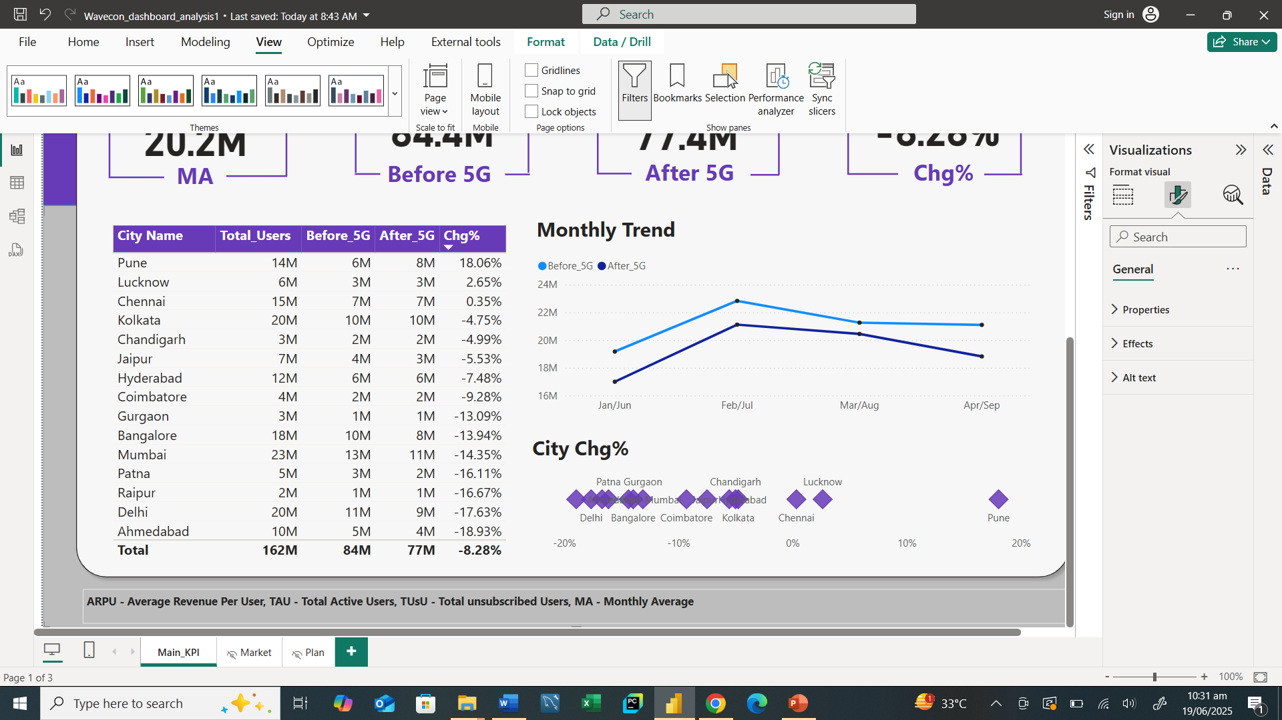
Underperforming KPIs Post 5G Launch
TAU - Total Active User
Cities with significant TAU decline and TUsU increase.
Pune is an exception with TAU growth.

Slide 9
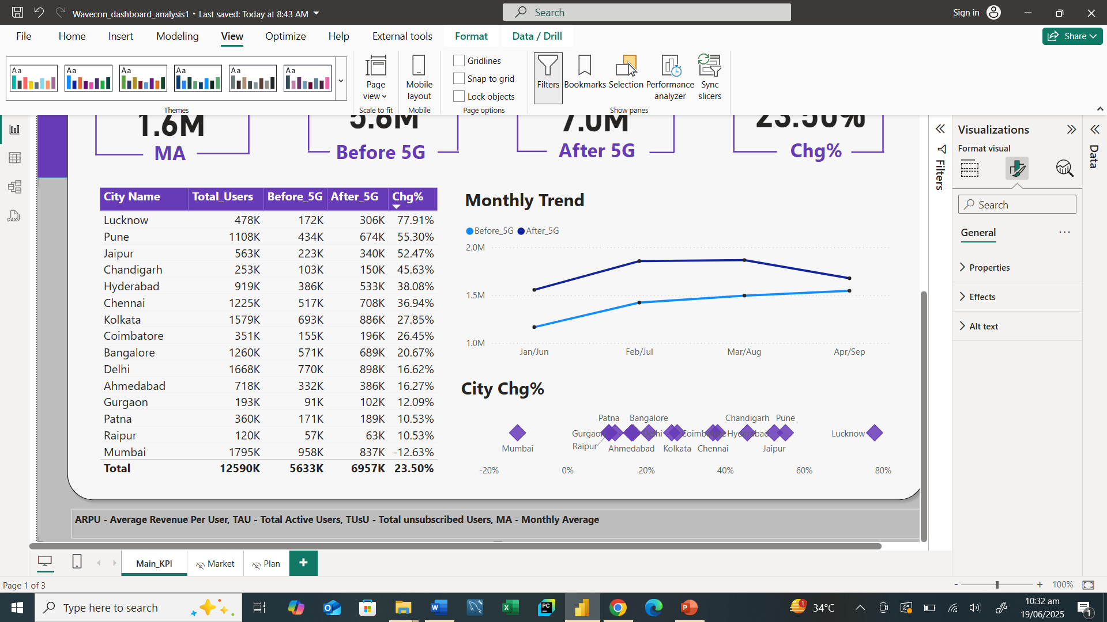
Underperforming KPIs Post 5G Launch
TUsU – Total Unsubscribe Users
TUsU increased by 23.5%.
Cities with significant TUsU increase.
Mumbai is an exception with TUsU Decline.

Slide 10
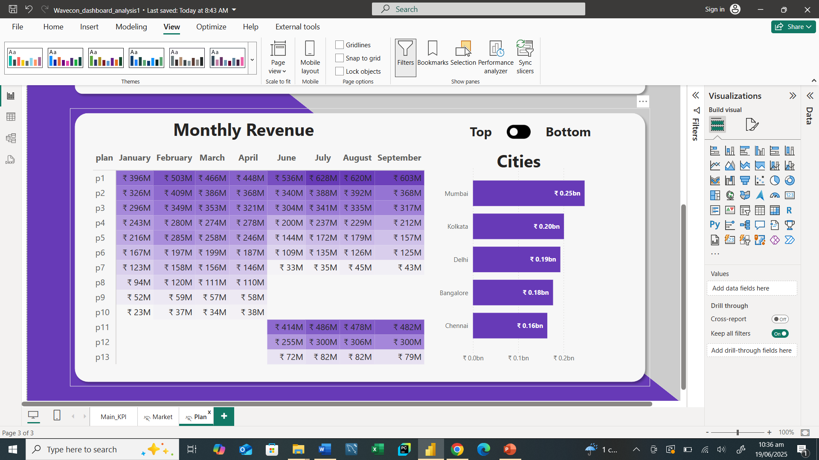
Plan Performance Post 5G Launch
Before 5G
After 5G

Slide 11
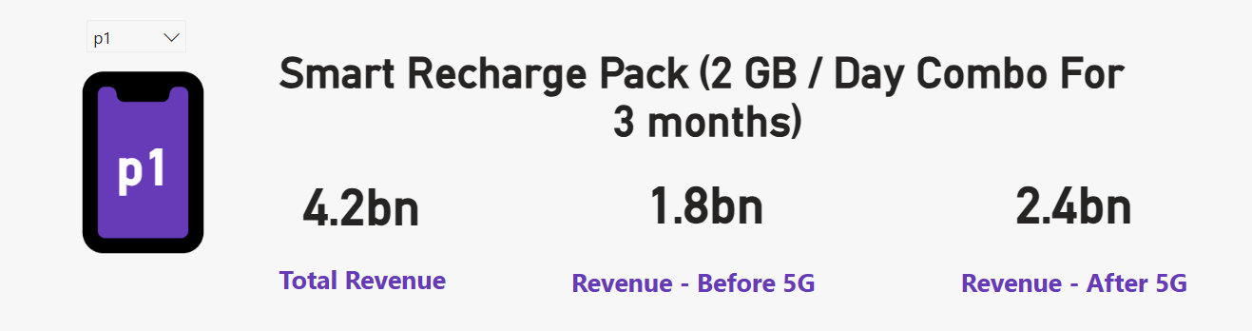
Plan Performance Post 5G Launch
Before 5G
After 5G
The P1 Plan is the best-performance plan.

Slide 12

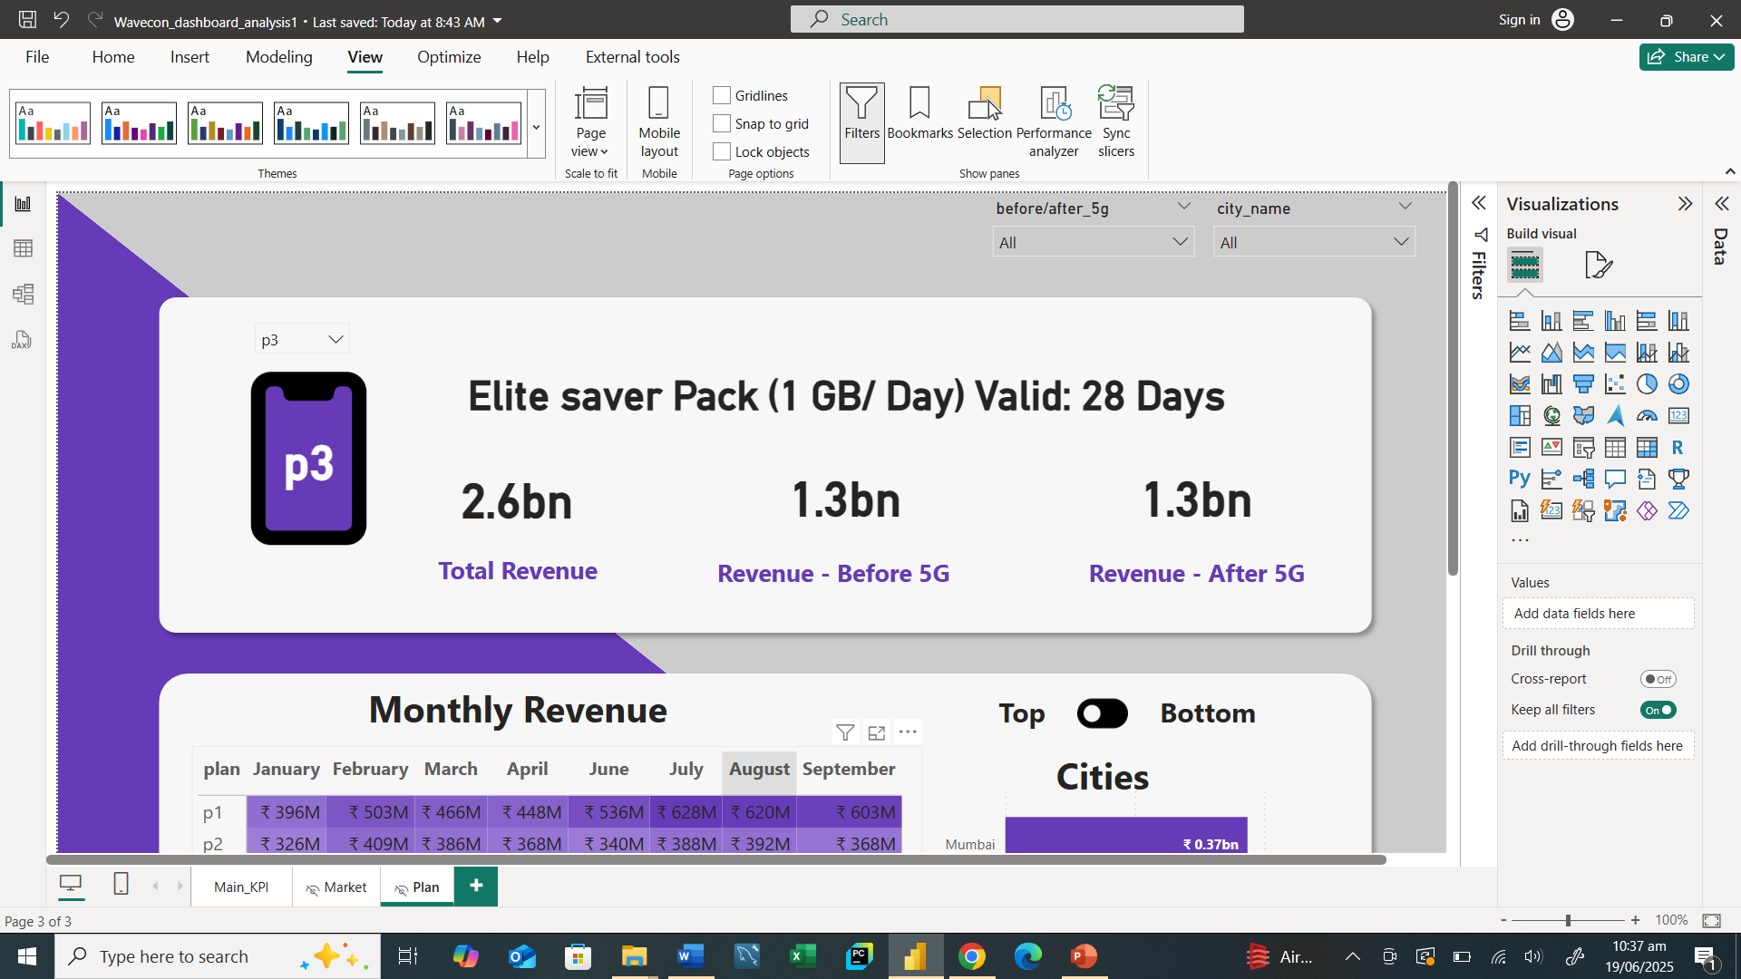
Plan Performance Post 5G Launch
Before 5G
After 5G
Plan P2 and P3 need improvement.

Slide 13
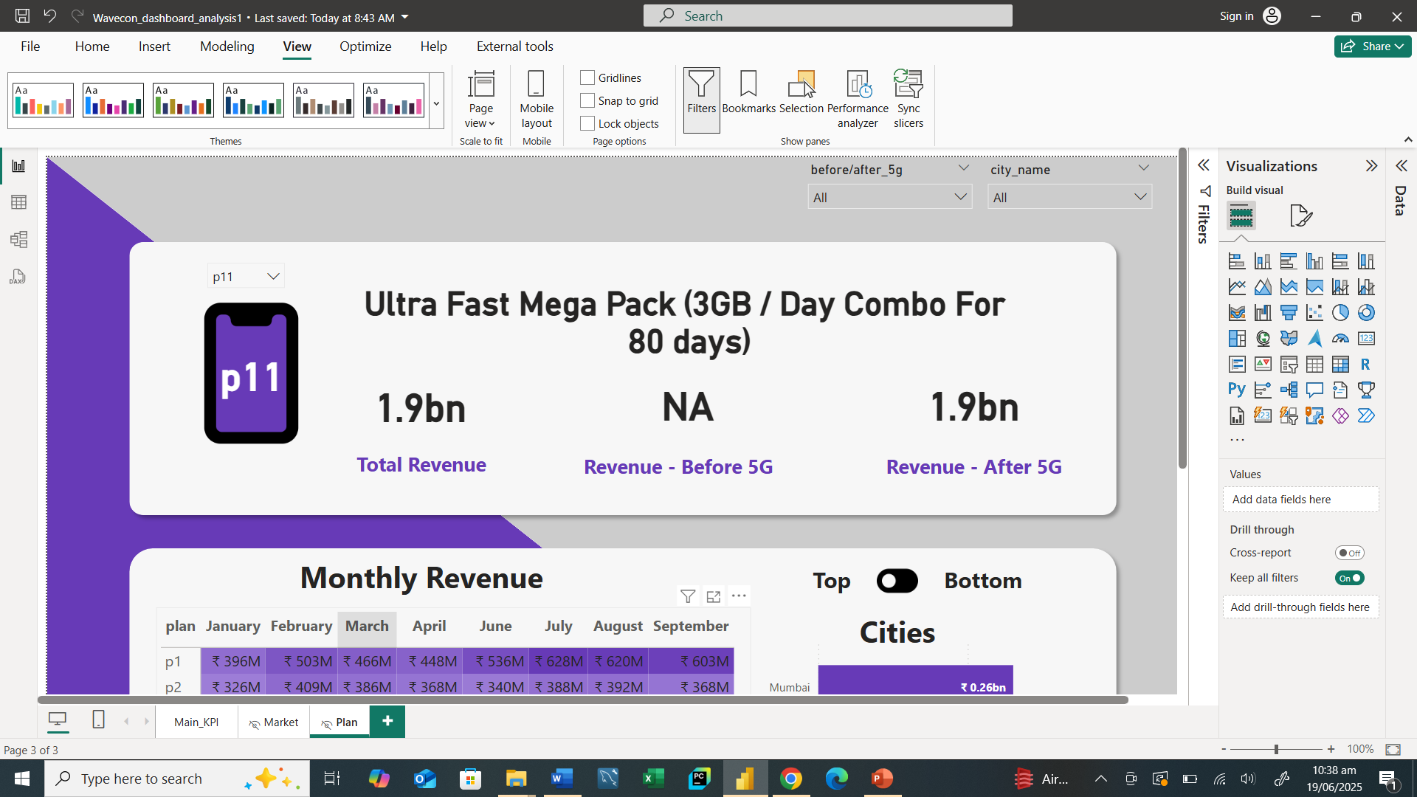

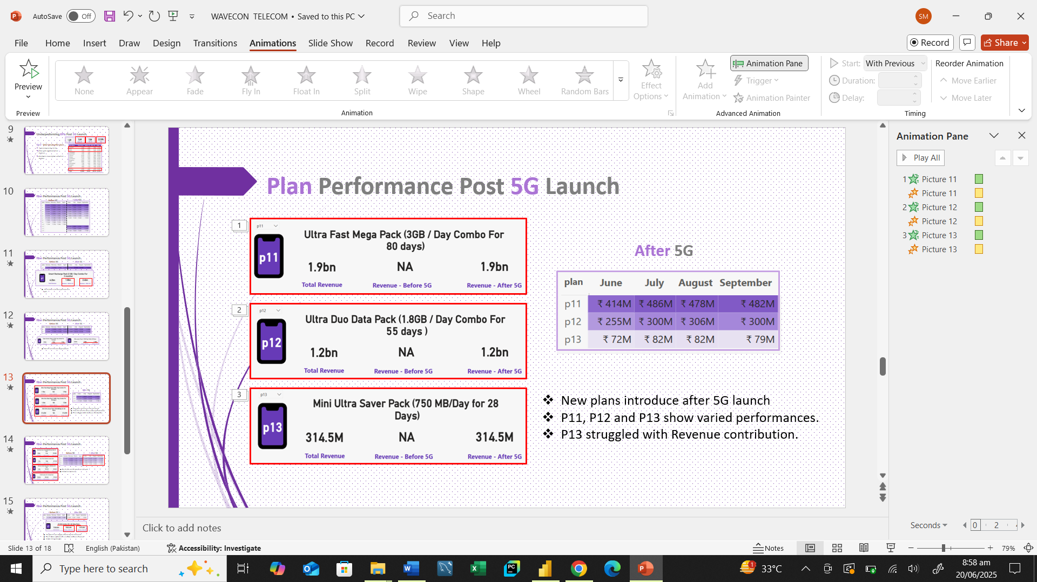
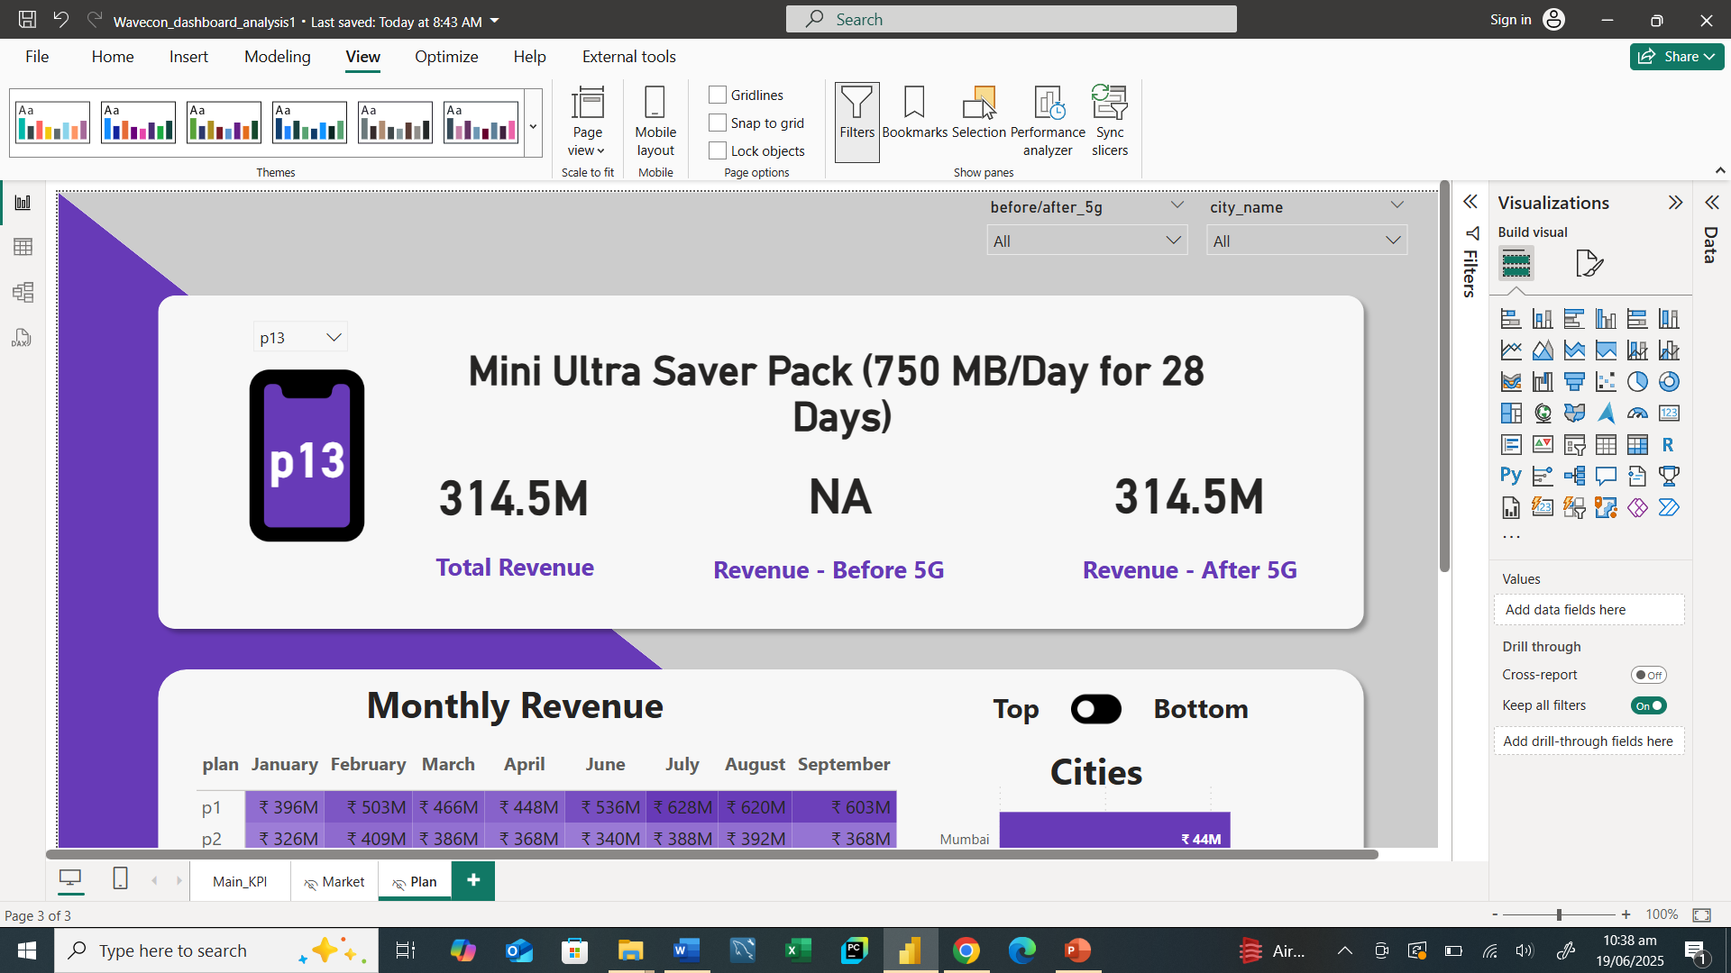
Plan Performance Post 5G Launch
After 5G
New plans introduce after 5G launch
P11, P12 and P13 show varied performances.
P13 struggled with Revenue contribution.

Slide 14
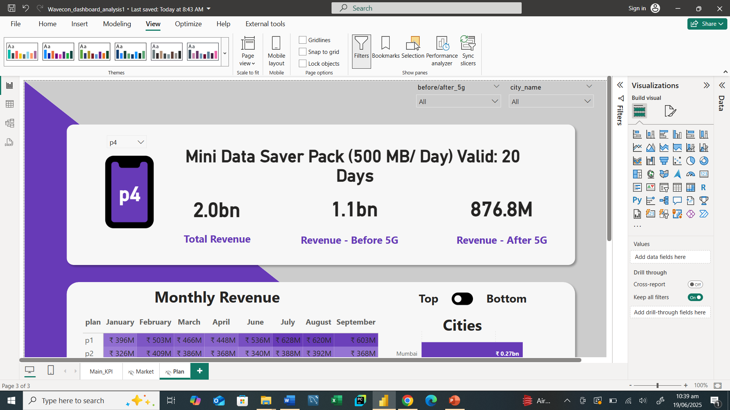
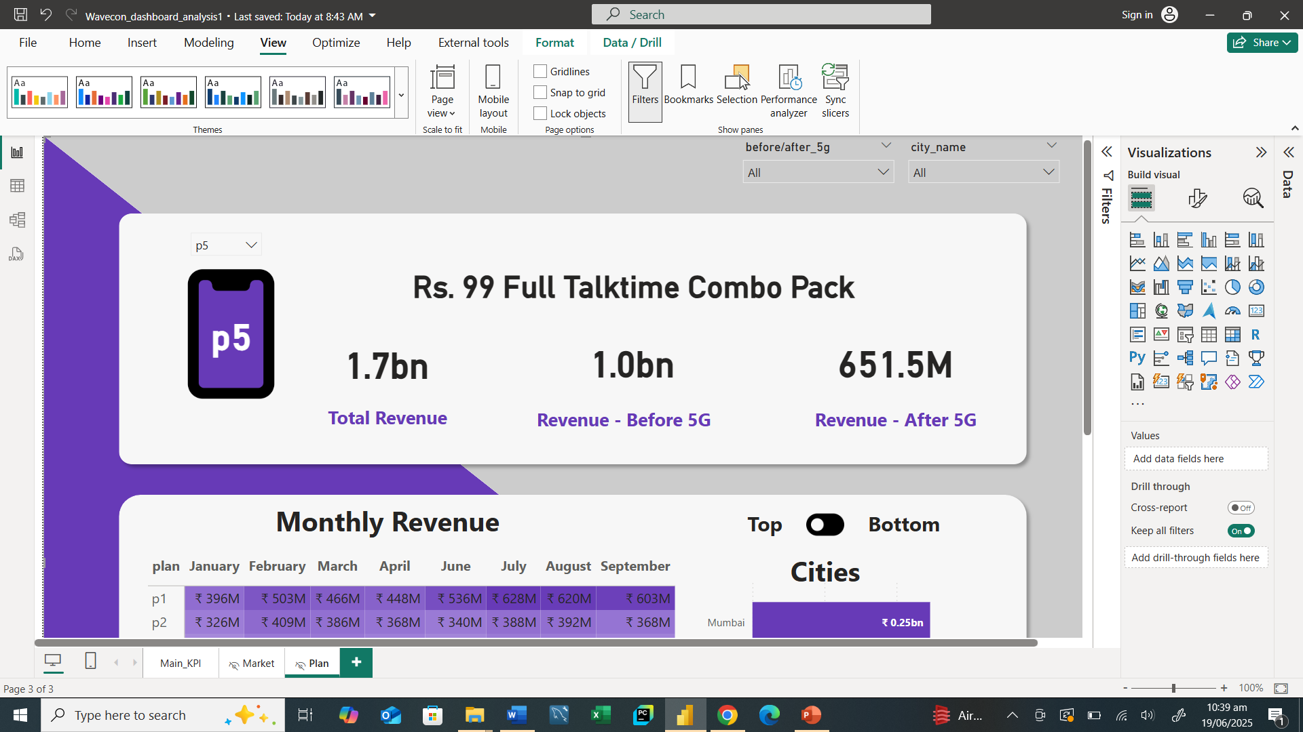
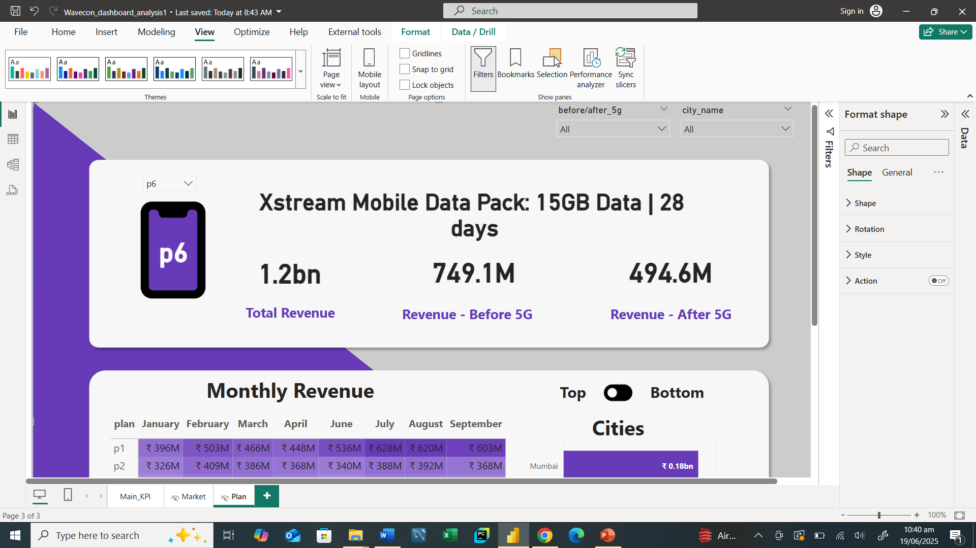

Plan Performance Post 5G Launch
Before 5G
After 5G
P4, P5, P6 and P7 plans are not well.
Decreasing revenues.

Slide 15
Plan Performance Post 5G Launch
Before 5G
After 5G
The plan P7 was largely affected by the 5G launch.
The P7 plan experienced a notable decline in revenue.
3G/4G data pack plan.

Slide 16

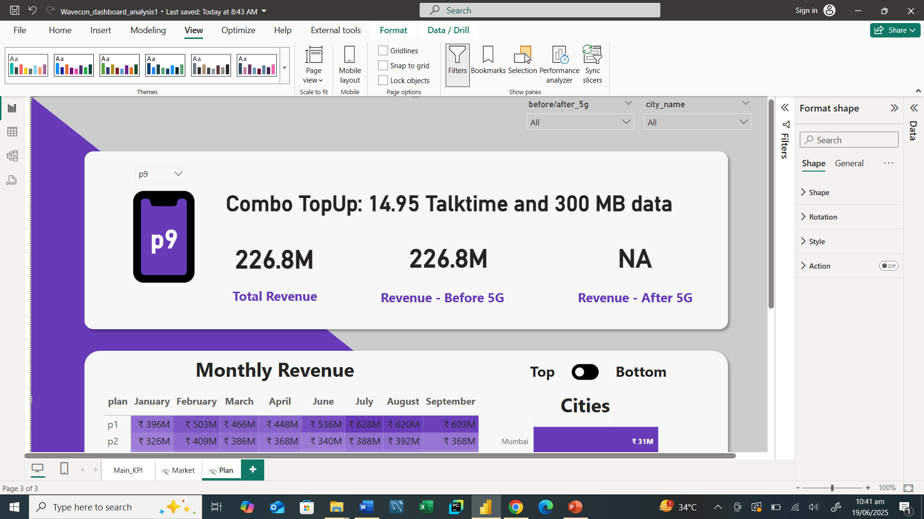

Plan Discontinuation
Before 5G
After 5G
Plans P8, P9 and P10 were discontinued.
Minimal contribution to revenue.

Slide 17
Conclusion
Challenges and opportunities
Adapting to the 5G market
Improvement underperforming plans
Discontinuing largely effected plan

Slide 18
Thank you

